Slide 1
Internet & Web
Lab 8: Internet in Daily life

Slide 2
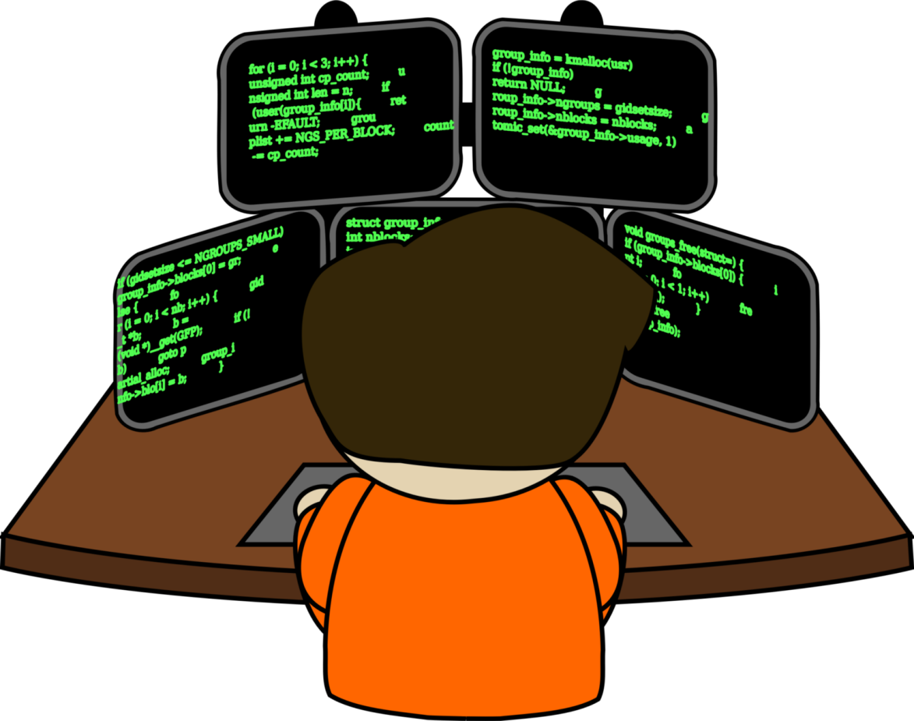

Welcome to Internet & Web Class

Slide 3

Use of Internet in our Daily Life

Slide 4
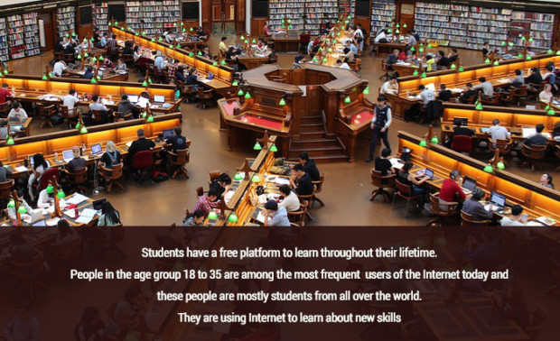
Uses of Internet in Students daily life

Slide 5
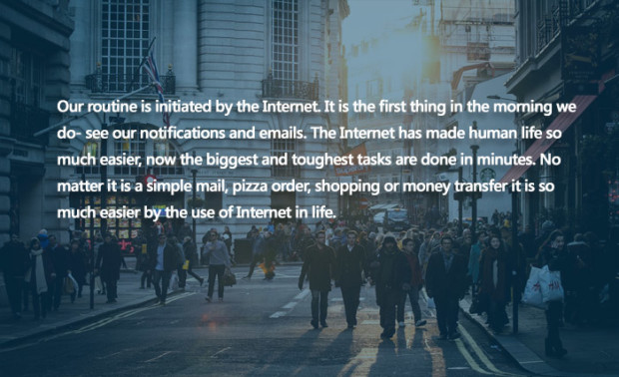
Uses of Internet to increase the speed of daily tasks

Slide 6
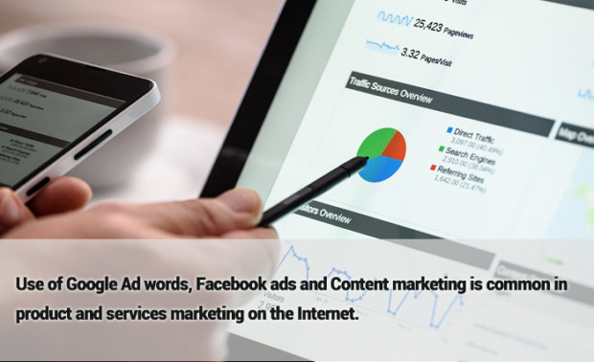
Uses of the Internet for business promotion and innovation

Slide 7
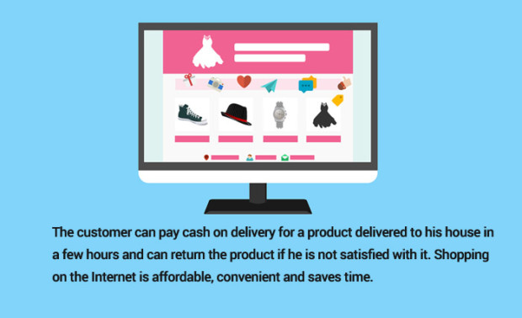
Uses of Internet for shopping in our daily life

Slide 8
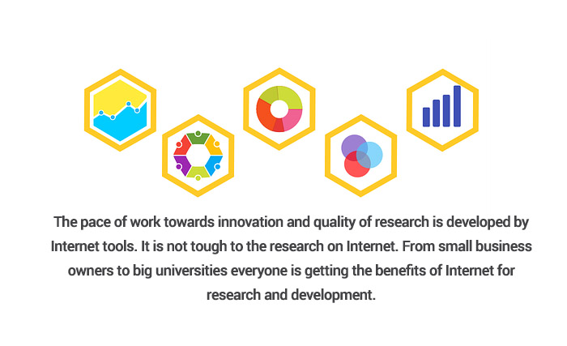
Use of Internet for research and development

Slide 9
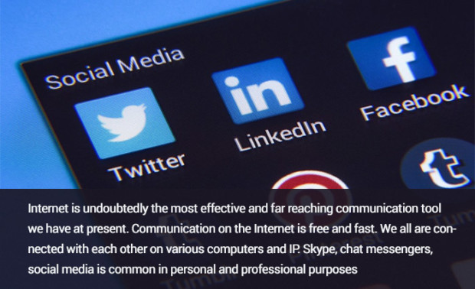
Use of Internet provide us quick and free communication

Slide 10
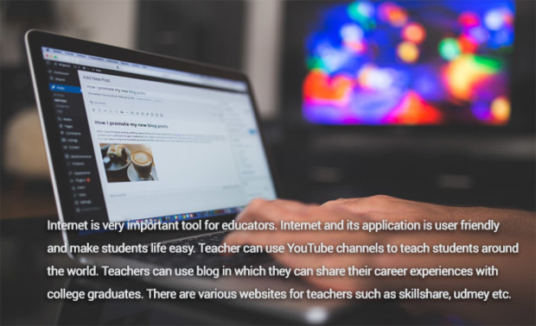
Uses of Internet for Teaching and Sharing

Slide 11
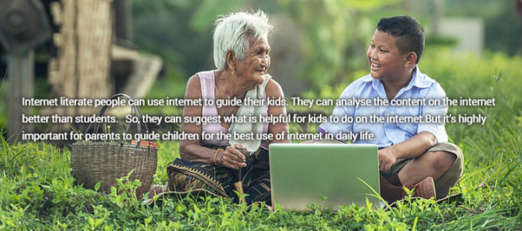
Uses of internet for parents

Slide 12
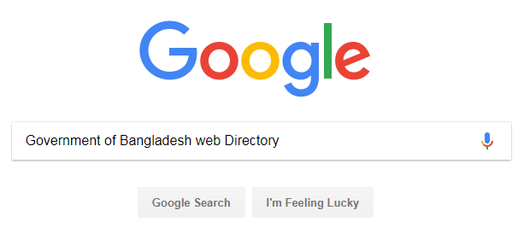
Government policies and schemes are easily accessible by the use of Internet

Slide 13

Today’s learning:
Importance of Internet in Our Daily Life
Thank You!

